Slide 1
Analyzing Chinese Restaurants in Lagos Nigeria
Ijegwa David Acheme

Slide 2
Introduction
The population of Chinese in Nigeria is increasingly growing, this is as a result of the growing trade relationship between both countries, currently all the major infrastructural works raging from railways, roads and power plants are handled by the expertise. With their presence comes also the need for their delicacies. In this work we intend to explore Chinese restaurants around one of the most popular hotels in Lagos and rank them based on user ratings so that we can make recommendations.

Slide 3
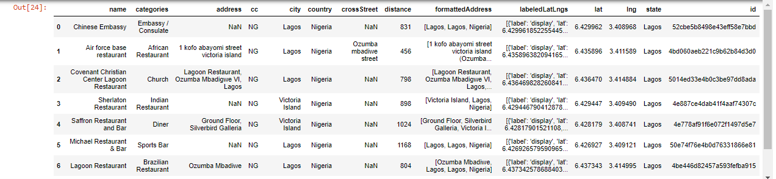
The Data
The data set we shall be utilizing for this work is retrieved from the foursquare location data provider API, it consists of the restaurant name, category, address, distance from the chosen hotel and id. This data is retrieved a JSON file and this is converted into a pandas data frame as shown in figure 1.

Slide 4
Methodology
From the foursquare’s API data, which were translated into a pandas data frame, we carried out the following exploratory analysis.
Visualization of all the Chinese restaurants in the neighborhood of the Federal Palace Hotel
Exploration of each of the restaurants within the neighborhood to find the users’ ratings
Exploration of the closest restaurant and the restaurant with the highest ratings to find the trending venues around it

Slide 5
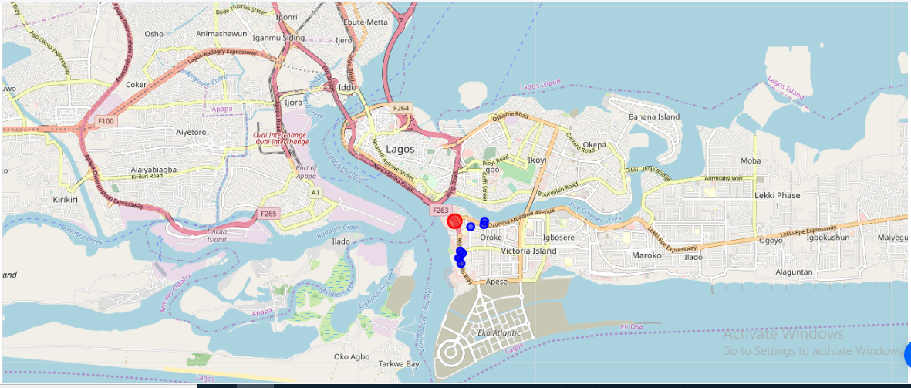
Results
In this result section I present the findings defined in the methodology section
Visualization of all the Chinese restaurants in the neighborhood of the Federal Palace Hotel

Slide 6
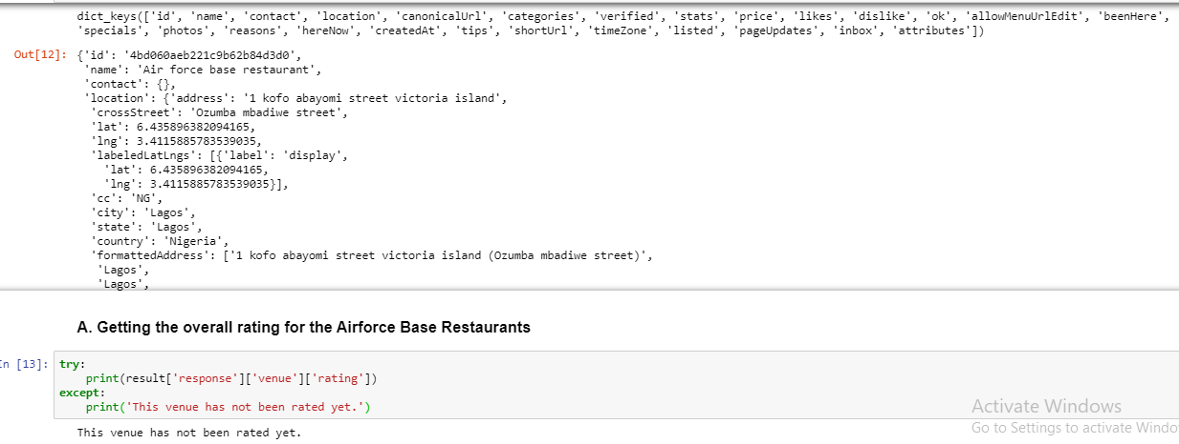
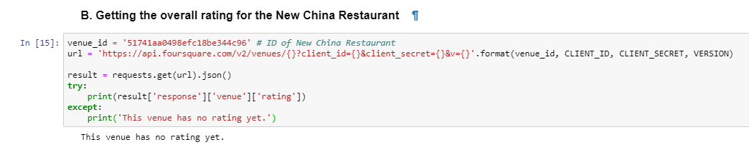
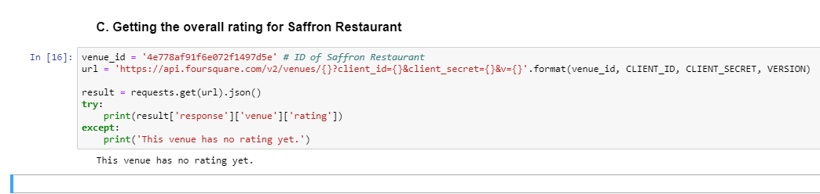
Results Con’td
we further explore the following restaurants; Airforce base Restaurant, New China Restaurant, and Saffron Restaurant. This is to enable us determine their user ratings and rank them accordingly, the results of this is shown in figures 4-6

Slide 7
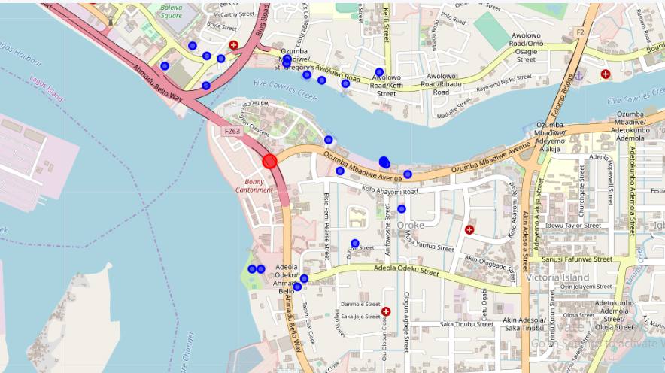
Exploration of Popular and Trending Venues around the Federal Palace Hotel
I further sought to find out the most popular venues around the hotel, using the foursquare API we obtained the JSON file containing this information and converted it into a pandas dataframe. Then using the folium library, I show a Map of the popular locations around the federal palace hotel. Figure 7.

Slide 8
Discussion
From the exploration and analysis of the location data of the Chinese restaurants in the neighborhood of the federal palace hotel, one of the foremost hotels in Nigeria’s commercial center, Lagos, we found that there are upto five restaurants that offer Chinese foods within its neighborhood. However the main goal of this project which was to rank these restaurants based on user ratings was not achieved as the available data from foursquare API showed that there are zero ratings for all the hotels.

Slide 9
Conclusion
In this project I set out to explore Chinese restaurants around a foremost Nigerian Hotel and to rank them based on user ratings. This would have presented an evidence based recommendation data to people desirous of Chinese delicacies within that neighborhood. However available data showed that there are zero ratings for this restaurants. One of two factors might be responsible for this; the restaurants have no online presence or the foursquare location data provider needs to update their database.

